Slide 1

OOP
Object Oriented Programming
Lecture 11
Lecture 1

Slide 2
Outline
Association, Aggregation, and Composition

Slide 3
Relationship Between Classes

Slide 4
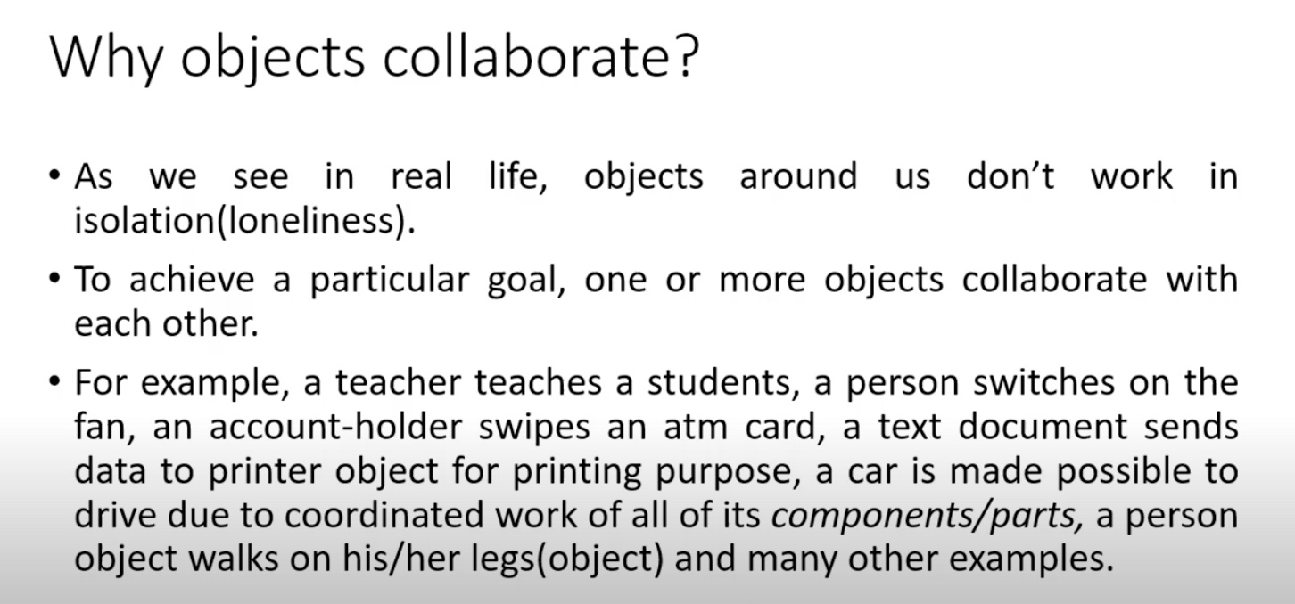

Slide 5
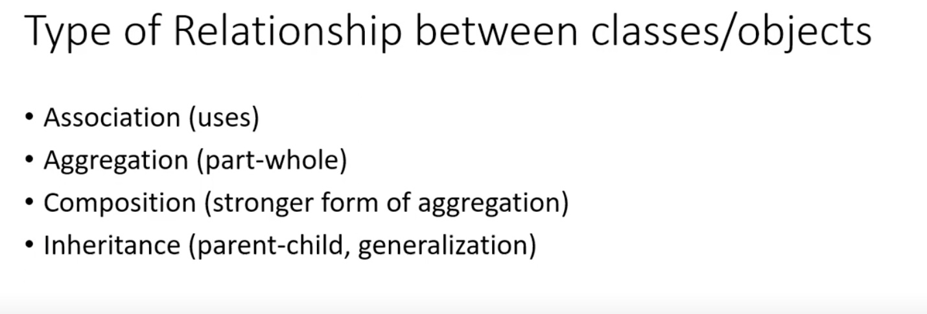

Slide 6
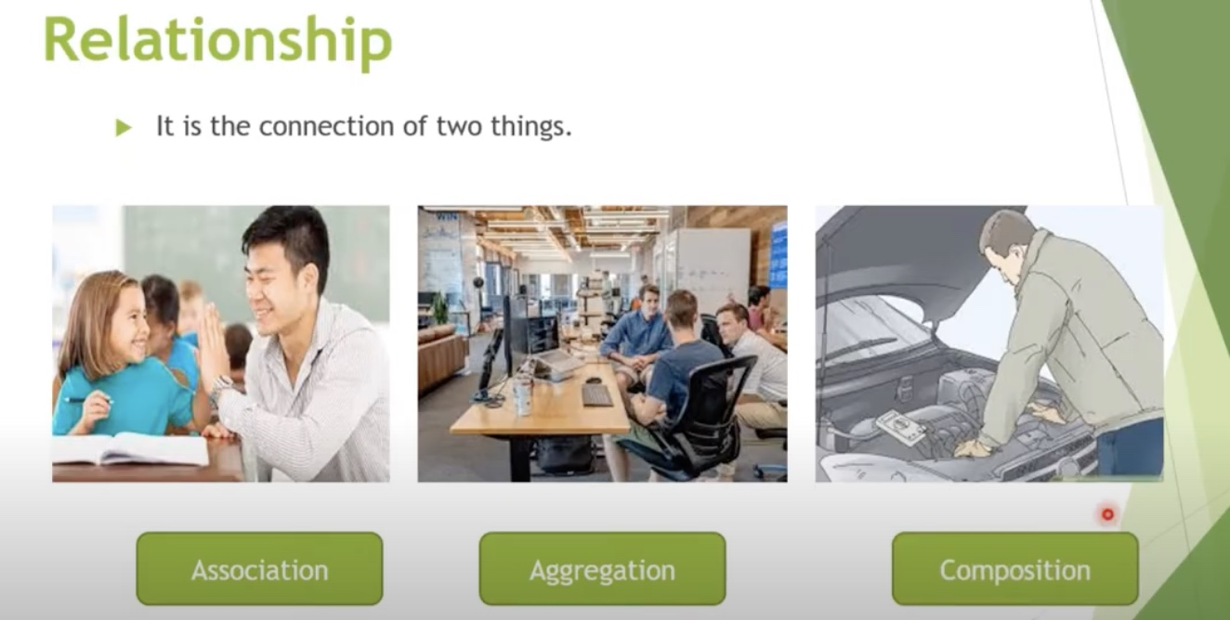

Slide 7
Association
- Association represents a simple relationship between two objects, where one object uses the other object. In this case, all objects have their own lifecycle and there is no owner.
- Association is a general term used to describe any relationship between two objects. It can be one-to-one, one-to-many, or many-to-many. The objects can exist independently, meaning the lifetime of one object does not depend on the other.
- Example of Association:
In an educational system, a Student may be associated with a Teacher in the context of the student attending a class or being taught by that teacher. However, the Teacher and Student objects exist independently of each other. If one of them is destroyed, the other remains unaffected.
Notes:
memory leak concept

Slide 8
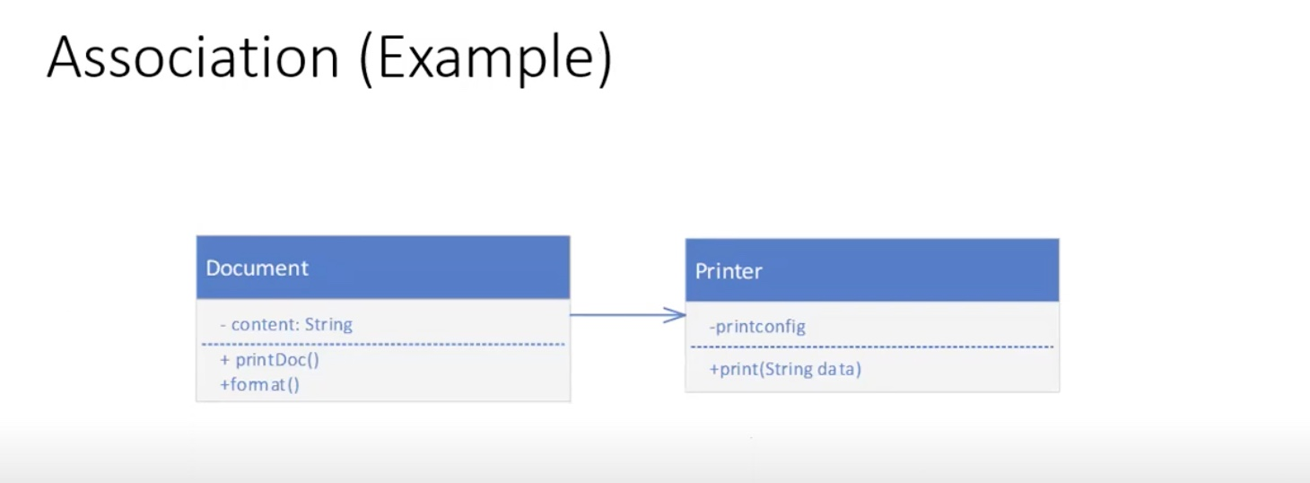

Slide 9
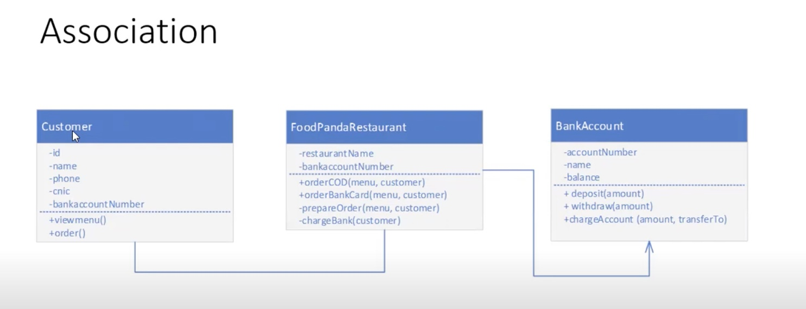

Slide 10
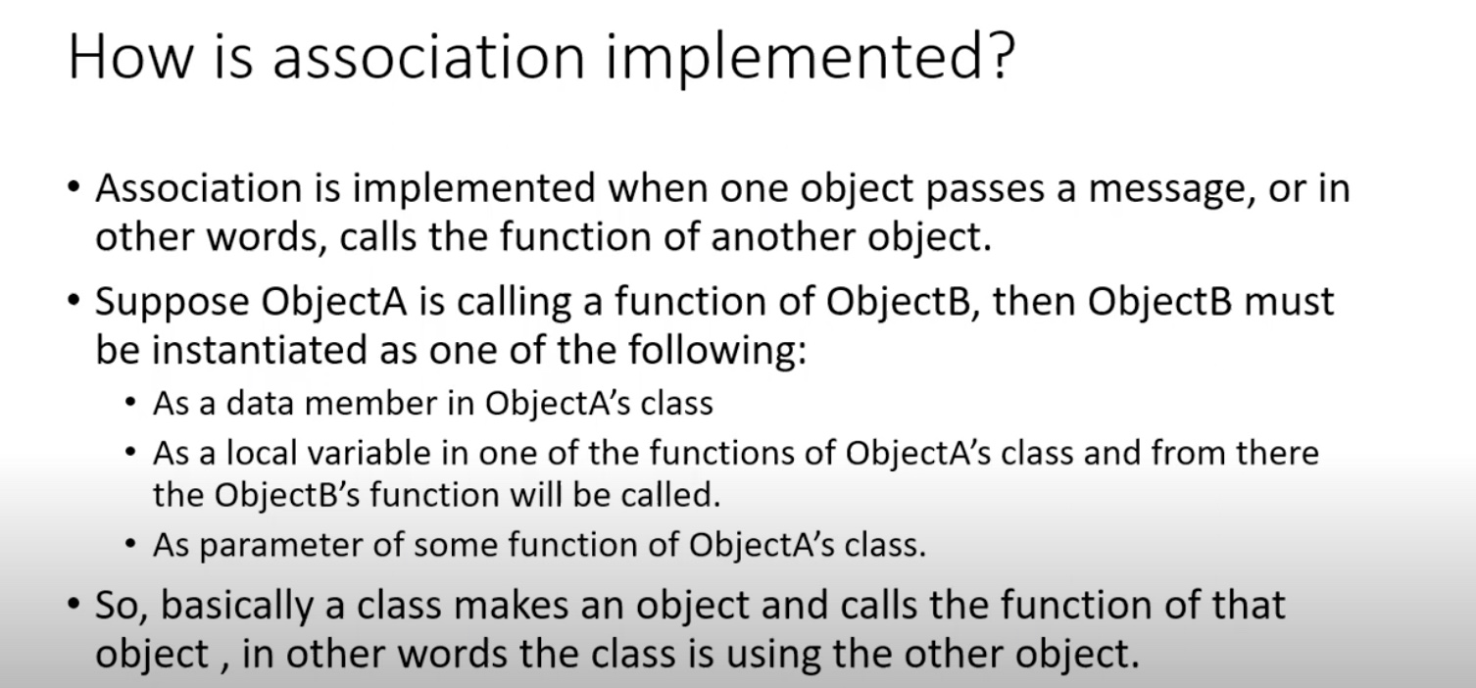

Slide 11
Coding Examples
Notes:
Task 2,

Slide 12
Aggregation
- Aggregation is a specialize form of association where all objects have their own lifecycles but there is an ownership like parent and child. Child object cannot belong to another parent object at same time. We can think of it as "has-a" relationship
Example: A single employee cannot belong to multiple companies, but if we delete the company, employ object will not destroy
Notes:
memory leak concept

Slide 13
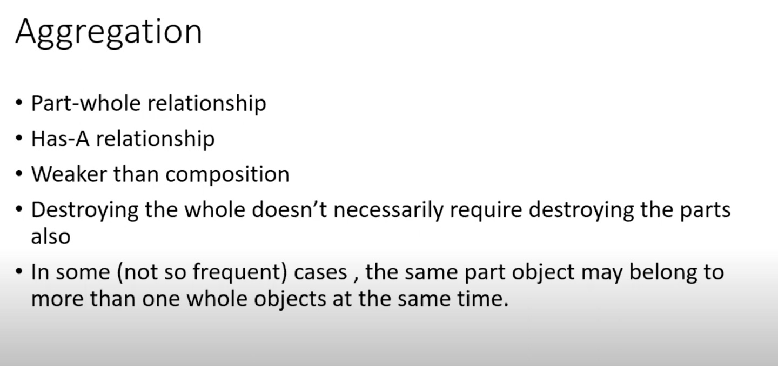
Aggregation
Notes:
memory leak concept

Slide 14
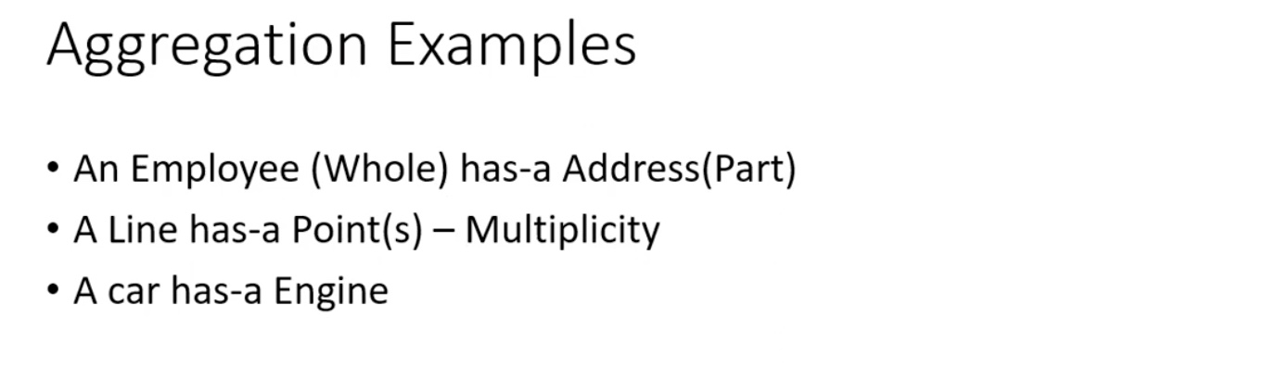
Aggregation
Notes:
memory leak concept

Slide 15
Coding Examples
Notes:
Task 2,

Slide 16
Practise Questions - Aggregation
Question 1:
Create a School that aggregates Teachers. Each Teacher can teach multiple Students. A Teacher can exist independently of the School. Implement the following:
Teacher Class: Stores the teacher's name and has a method to teach a Student.
Student Class: Stores the student's name and can display it.
School Class: Stores up to 3 teachers and can display all teachers. It should aggregate the teachers and allow them to teach students.

Slide 17
Composition
-Composition is a specialize form of aggregation. It is a strong type of aggregation. Here the parent and child objects have coincident lifetimes. Child object doesnot have its own lifecycle and if parent object gets deleted, then all of its child object will also be deleted.
- Lets take an example of relationship between a person and its birthday. There is no independednt life for birthday. If we delete the person, birthday will also be automatically deleted.
Notes:
memory leak concept

Slide 18
End of Lecture

